Slide 1


Operating Systems:
Files
Fabrice BOISSIER <fabrice.boissier@epita.fr>
2021-11-02

Slide 2
Why storing data?
Functionally in mankind:
Persistence of data
Keep data for a later use (hours, days, weeks, months, years, …)
Remember the past/facts/history
Keep a trace of ownership or transaction
Identify peoples
…

Slide 3

Why storing data?
Knowledge ladder
[Klaus North & Gita Kumta 2018 Knowledge management : Value creation through
organizational learning]
Data is essential, yes… but not only data.
The « knowledge era » requires information and data.
ASCII and UTF-8 are the « symbols ». Files contain « data ».
Notes:
A bit of « knowledge management »… Files and file systems are managing « data », BUT they require specific « symbols » foundations.
ASCII, UTF-8, … or even « EBCDIC » are the symbols! Files on a disk, or DBMS tables contain the data.

Slide 4
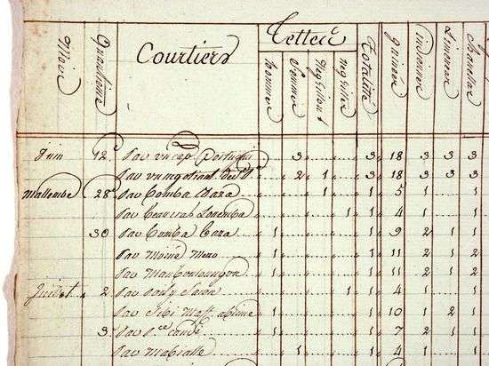
Very old history: how to store data?
(I promise there are 4 slides only)
Obviously, by writing in a structured document…
You should see what is recurrent text on each page, and what is added by the user
Well done, you know what is in the declaration of the « struct », and what is put in each field during execution of the « process » by a human!

Slide 5
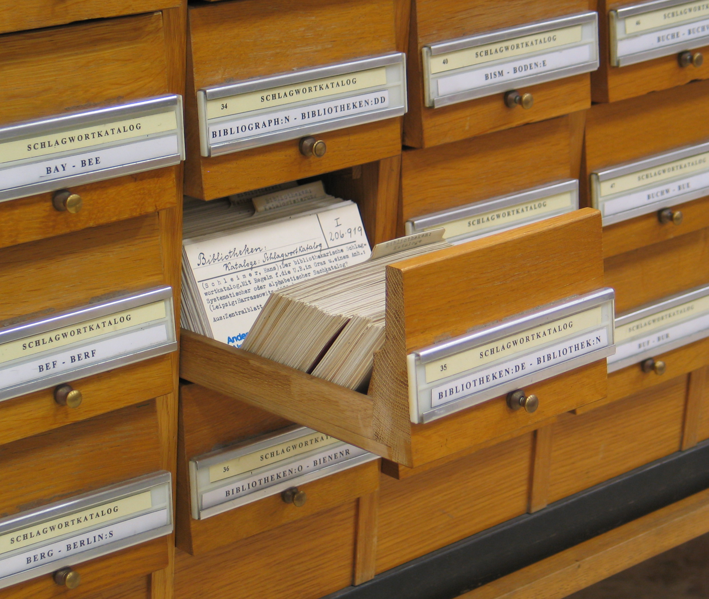
Very old history: where to store data?
(I promise there are 4 slides only)
1 card is equivalent to 1 record in a database or in a dataset (or 1 line in a file)
1 drawer is equivalent to 1 table in a database, or 1 file
1 furniture is equivalent to 1 database, or 1 directory
Notes:
In french « un fichier » can be translated as « a file », but it’s also a furniture where we store record cards

Slide 6
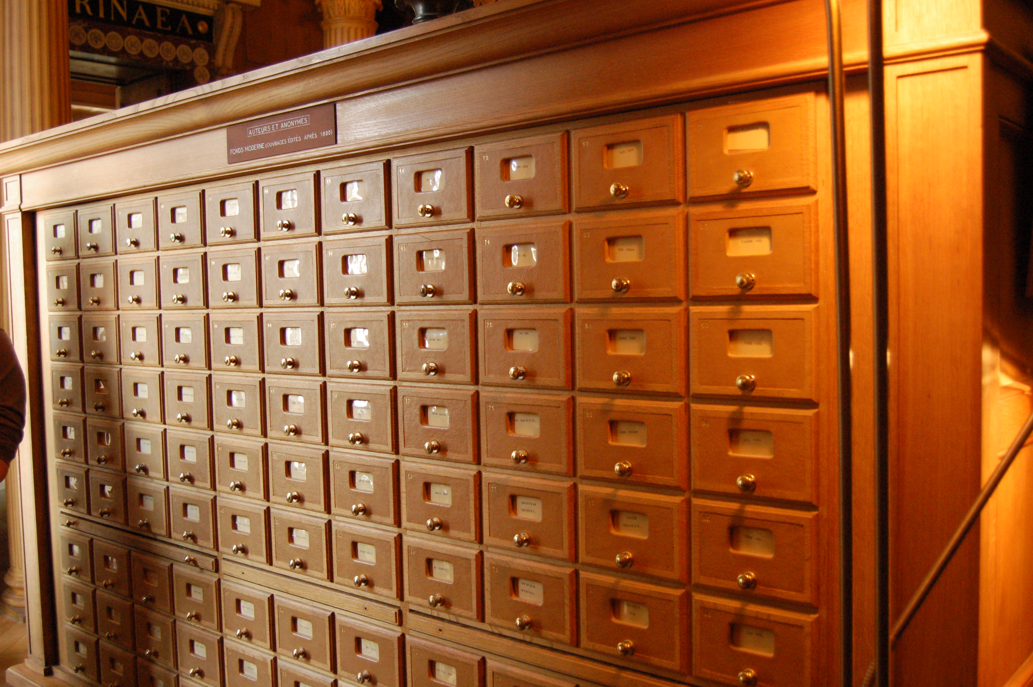
Very old history: how to find back data?
(I promise there are 4 slides only)
Where is the data about John Smith?...
Let’s search in the « J » or « S » closets until we find it…
(This furniture is litterally a « fichier » [file] in french)

Slide 7
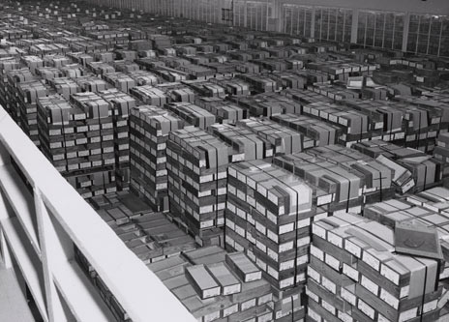
Old history: how to find back data?
(I promise there are 4 slides only)
Decades later:
Where is the data about John Smith?...
(and which John Smith are we talking about?)
IBM punch card storage at the NARA (National Archives and Records Administration) (1 cardboard box = 2,000 cards)

Slide 8
Why storing data?
Technically with IT:
Persistence of data
Keep data even after a process has ended
or between each reboot… or in case of a power outage
Quantity of data
Large amount of data that do not fit in memory
Data sharing
Share the same data between multiple processes

Slide 9
Glossary
Media or Support:
The hardware that contains blocks
Can be seen as a huge array with cells of a fixed size
…ho ho ho, it looks like memory… (« auxiliary memory » ?...)
Block:
Contains a fixed size of data
Minimum part of a file
Also, the « cells » contained in the media
Directory:
An abstract container of files
File:
An abstract container of records or raw data

Slide 10
Reminder on measures & prefixes
Value |  |  | SI
10^3 | 1000 | k | Kilo
10^6 | 1000^2 | M | Mega
10^9 | 1000^3 | G | Giga
10^12 | 1000^4 | T | Tera
10^15 | 1000^5 | P | Peta
10^18 | 1000^6 | E | Exa
10^21 | 1000^7 | Z | Zetta
10^24 | 1000^8 | Y | Yotta
Value |  |  | IEC
2^10 | 1024 | Ki | Kibi
2^20 | 1024^2 | Mi | Mebi
2^30 | 1024^3 | Gi | Gibi
2^40 | 1024^4 | Ti | Tebi
2^50 | 1024^5 | Pi | Pebi
2^60 | 1024^6 | Ei | Exbi
2^70 | 1024^7 | Zi | Zebi
2^80 | 1024^8 | Yi | Yobi
In formal documentation, you might find the power of two version of the units…
Just remember it exists and some conversions are sometimes required
1KB = 0,97 KiB 1MB = 0,95 MiB 1GB = 0,93 GiB …

Slide 11
Physical Storage

Slide 12
Access methods
Sequential access
Needs to read (or at least passes on) each cell before the required data
Each new data is written at the end of the media
Typical example: magnetic tape
Random access
Direct access to data (or nearly direct) for read or write
Optionnally by using an index updated after each new write/delete
Typical examples: disk drives, flash memory

Slide 13
Access methods
Access methods concern multiple aspects
Access to a record « within » a file…
Usually as a developper by organizing/structuring your data
Access to a file « within » a media…
Usually as a program by using file system services
(In a certain way, accessing data within a stack or a fifo is not so far)

Slide 14
Sequential medias
Magnetic tapes
You must unroll/rewind the media until the beginning of your data
Very VERY cheap
LTO: version 8, 12TB raw/30TB compressed, for 75~140€
Very VERY dense
LTO: version 8, 12~30TB on 10x10x2cm for 200g (strip size: 960m)

Slide 15
Sequential medias
0
10
Magnetic tapes
Current usage:
Archiving
Backup (is replaced by disks and regular medias)
Might be WORM (Write Once Read Many)
Even if the « sequential medias » tends to disappear, the abstract concept is similar to some structures, like the LIFO.
For example in any stack container (like in C, or the std::stack in C++) you must use « top » to get the element, and « pop » to go deeper.
20
30
Notes:
…and that’s right, in a magnetic tape, there are 2 stacks: one is emptyied in the other one… and it rolls back in order to get back the data in the correct order.

Slide 16
Random access medias
Disk drives, Flash Memory, …
You directly access data by giving its position on the device
Exactly like pointers in memory, except its an address « on » the device
Cost, density, speed, durability … are variables
Choose wisely based on the characteristics you wish

Slide 17
Random access medias
Disks
Sector, track, disk, cylinder
Cylinder, Head, Sector (CHS)
Sector: smallest physical unit
track
disk
Sectors
cylinder
head
Notes:
Track : a full track of blocks on a disk
Disk : all the tracks on one face of a disk => perfect for a long data/simulate sequential access on a random access media
Cylinder : one specific track on every face of every disks => perfect for high performance : the heads that read can all works simultaneously

Slide 18
Random access medias
Disks
Currently, using sectors only (see LBA)
Firmwares abstract the hardware…
Your kernel asks for sectors, the firmware gives sectors… (The firmware manages the disk’s internal buffers and the mapping)
LBA Block = (C × Head per Cylinder + H) × Sectors per Tracks + (S − 1)
See SMR and CMR if you expect to buy a NAS…
These are the physical methods to store data (North / South in magnetism, size of the cells, …)
The lower level still has an impact on the usage and File System

Slide 19
Random access medias
Disks
Pretty flexible, but still a bit slow and dies easily
Capacities are pretty large
Access time is slow, but waaaay better than tapes
Too much mechanical parts == fragile
See RAID for redundancy
Data is copied multiple times...
…or blocks are replicated
If one disk dies, the data is still intact

Slide 20
Random access medias
Flash Memory
Extreme speed of access, but less capacity of storage
See NAND and NOR memory cells
And variable lifetime: each write reduces the lifetime
Cells are sensibles… (see NAND and NOR memory cells)
Again: the firmware manages the physical locations in order to avoid destroying the memory cells too quickly
Used in SSD (Solid States Disks), Memory Card, …

Slide 21
Physical supports read and store data… …Kernel manages how to organize & retrieve data for a user without knowing the physical supports

Slide 22
File Systems

Slide 23
File Systems: Objectives
Functionally:
How to store data efficiently?
How to retrieve data quickly?
Technically:
How to organize data physically?...
…and expose a nice abstraction?

Slide 24
File Systems
Abstraction from the physical supports
No need to search for sectors
Uses « blocks » (or « clusters »)
Block: smallest allocation unit managed by the file system
The file system manages the relations between sectors and blocks 1 block/cluster is 1, 2, 4, 8, 16, … sectors (N * sector size)
Currently: sector size = 4096 B = 4KiB
Presents data within abstracts objects
Files, directories, …
Notes:
Reminder : sector = smallest unit « on » the drive block = smallest unit managed by the file system
Therefore, block size is always a mutiple of the sector size

Slide 25
File Systems
Tons of filesystems…
FAT32, NTFS, ext2/3/4, Reiser4, ZFS, …
ISO9660, exFAT, …
Some FS have special objectives
Network or distributed file system
Reminder: FS are dependant of the physical support!

Slide 26
File Systems
File
Contiguous records packed within a container
Even movies or pictures are built with a precise structure and records
Repetition of images, pixels, …
Only the right interpretation of that data makes sense
Well, it can also be one record of raw data
Like raw data from a probe
Only the right interpretation of these data makes sense
apache.log
README.txt
moulette.sh
chiche.mov
[Tue Mar 02 08:59:20…
Shell project …
#! /bin/sh …
A2fPqt 2$^!Z&43…

Slide 27
File Systems
File
Files are identified by their names
How to retrieve them in the physical support?
Some attributes are attached
It depends on the file system and which attributes are managed
apache.log
README.txt
moulette.sh
chiche.mov
[Tue Mar 02 08:59:20…
Shell project …
#! /bin/sh …
A2fPqt 2$^!Z&43…

Slide 28
File Systems
File
Examples of attributes:
Name
Size (logical, physical, maximal allowed size, …)
Date of creation, access, …
Permissions (user/group/other, creator, owner, …)
…
apache.log
README.txt
moulette.sh
chiche.mov
[Tue Mar 02 08:59:20…
Shell project …
#! /bin/sh …
A2fPqt 2$^!Z&43…

Slide 29
File Systems
File
In some file systems, each file has a type
Typically in the Windows world: the extension (the 3 last letters) .exe => executable, .bmp => bitmap, .txt => text, …
« Magic numbers »
(On some OSes, the type was stored in the file attribute)
Currently: everything is just a flat file
Depending on the type, the OS might know what to do with it (which program to use and/or how to interpret data inside)
apache.log
README.txt
moulette.sh
chiche.mov
[Tue Mar 02 08:59:20…
Shell project …
#! /bin/sh …
A2fPqt 2$^!Z&43…

Slide 30
File Systems
File
Operations on files:
Create
Delete
Open
Close
Read
Write…
apache.log
README.txt
moulette.sh
chiche.mov
[Tue Mar 02 08:59:20…
Shell project …
#! /bin/sh …
A2fPqt 2$^!Z&43…
Notes:
Write from where to where?

Slide 31
File Systems
File
Operations on files:
Append (writes at the end of the file)
Seek (moves the read/write cursor inside the file)
Get Attributes
Set Attributes
Rename
apache.log
README.txt
moulette.sh
chiche.mov
[Tue Mar 02 08:59:20…
Shell project …
#! /bin/sh …
A2fPqt 2$^!Z&43…

Slide 32
File Systems
Directory (or folder)
Abstract container of files
Well, it does have a physical existence and it contains data
/
Apache
EpiShell
sgoinfre
apache.log
README.txt
moulette.sh
chiche.mov
[Tue Mar 02 08:59:20…
Shell project …
#! /bin/sh …
A2fPqt 2$^!Z&43…

Slide 33
File Systems
Directory (or folder)
Directories are also identified by their names
And also have attributes (that may vary depending on the file system)
/
Apache
EpiShell
sgoinfre
apache.log
README.txt
moulette.sh
chiche.mov
[Tue Mar 02 08:59:20…
Shell project …
#! /bin/sh …
A2fPqt 2$^!Z&43…

Slide 34
File Systems
Hierarchy of directories and files
Check hier(7) for UNIX hierarchy and where to store what
/
Apache
EpiShell
sgoinfre
apache.log
README.txt
moulette.sh
chiche.mov
[Tue Mar 02 08:59:20…
Shell project …
#! /bin/sh …
A2fPqt 2$^!Z&43…

Slide 35
File Systems
Partition (or old definition of « Volume »)
A section on the physical support
Separates the physical support into smaller storage spaces
Might be one partition with the full physical support into it
Physical support (blocks)
Partition 1
Partition 2

Slide 36
File Systems
Organization of files and folders within a partition
Some file systems might be distributed on multiple physical supports…
…or through a network protocol
See also NFS, AFS, ZFS, DFS, …
Apache EpiShell …
[Tue Mar 02 08:…
Shell project…
#! /bin/sh …

Slide 37
File Systems: Other objectives
How to keep a list of free blocks? (Similar to malloc(3))
How to quickly find a free block?
How to avoid fragmentation?
How to find the blocks that compose a file?
How to store attributes of files and directories?
(Owner, group, rights, last access, date of creation, …)

Slide 38
FAT example

Slide 39
File Systems: FAT example
( http://ntfs.com/fat_systems.htm ) ( http://www.c-jump.com/CIS24/Slides/FAT/FAT.html )
FAT (File Allocation Table)
FAT12, FAT16, FAT32: evolutions based on bigger requirements
One of the most simple file system
Very easy to implement
List of clusters and their states (free/broken/used)
Content in a linked list of clusters
Partition Boot Sector
FAT
Data (folders and files)

Slide 40
File Systems: FAT example
FAT (File Allocation Table)
1st part contains « Partition Boot Sector »
2nd part contains the file allocation table (a structure)
Last part contains data (contents of files and folders)
Partition Boot Sector
FAT
Data (folders and files)

Slide 41
File Systems: FAT example
FAT (File Allocation Table)
1st part contains « Partition Boot Sector »
2nd part contains the file allocation table (a structure)
It is optionnally duplicated in a 3rd part, for corruption check
Last part contains data (contents of files and folders)
It begins with the root folder with a predefined size
Partition Boot Sector
FAT (1)
FAT (2)
root folder
Data (folders and files)

Slide 42
File Systems: FAT example
FAT: Partition Boot Sector
Fixed size
Can directly be mapped in memory and read ;)
Contains informations about the partition
Size of sectors, sectors per tracks, volume label, FAT version, …
Size of the FAT (1) and FAT(2) (number of sectors used)
Size of the root folder (number of entries inside)
Contains the code for booting
Partition Boot Sector
FAT (1)
FAT (2)
root folder
Data (folders and files)

Slide 43
File Systems: FAT example
FAT: File Allocation Table
Contains a list of all the clusters and their states
Size is fixed when the physical support was formatted
Clusters 0 and 1 are reserved
First available cluster for data is the cluster 2
Linked list of files
A folder is just a file with a specific attribute
Partition Boot Sector
FAT (1)
FAT (2)
root folder
Data (folders and files)

Slide 44
File Systems: FAT example
FAT: File Allocation Table
File: Linked list of clusters
A file is an entry in a « Directory Entry », that points to a 1st cluster
Each cluster has the address of the next one, or an « EOF » indicator
Folder: Linked list of files
A folder is just a file with a specific attribute
And its content is a « Directory Entry » (we’ll see later what it is)
Partition Boot Sector
FAT (1)
FAT (2)
root folder
Data (folders and files)

Slide 45
File Systems: FAT example
FAT: File Allocation Table
Huge array containing state of each cluster in data
0x0000 : Free
0xFFF7 : Bad cluster (it shouldn’t be used by the file system)
0xFFF8 – 0xFFFF : Last cluster of a file (« EOF »)
(else) : Next cluster for this file
Partition Boot Sector
FAT (1)
FAT (2)
root folder
Data (folders and files)

Slide 46
File Systems: FAT example
FAT: File Allocation Table
Cluster | Content
[2] | 0
[3] | 4
[4] | 65,535
[5] | 0
… | …
Partition Boot Sector
FAT (1)
FAT (2)
root folder
Data (folders and files)

Slide 47
File Systems: FAT example
FAT: File Allocation Table
Cluster | Content
[2] | 0
[3] | 4
[4] | 65,535
[5] | 0
… | …
Cluster | Content
[2] | Free cluster
[3] | *data* [see 4]
[4] | *data* [end]
[5] | Free cluster
… | …
Partition Boot Sector
FAT (1)
FAT (2)
root folder
Data (folders and files)

Slide 48
File Systems: FAT example
FAT: File Allocation Table
Cluster | Content
[2] | 0
[3] | 4
[4] | 65,535
[5] | 0
… | …
Cluster | Content
[2] | Free cluster
[3] | *data* [see 4]
[4] | *data* [end]
[5] | Free cluster
… | …
Partition Boot Sector
FAT (1)
FAT (2)
root folder
Data (folders and files)

Slide 49
File Systems: FAT example
FAT: Folders and files
Contains clusters of files and folders
Files: pure data within the cluster
Folder: directory entry structure
Partition Boot Sector
FAT (1)
FAT (2)
root folder
Data (folders and files)

Slide 50
File Systems: FAT example
FAT: Folders and files
Directory entry (32 Bytes): one per file or subfolder
Name (8 chars + 3 chars) => FILENAME.TXT
Attribute byte (8 bits) => archive, system, hidden, read-only
Create time (24 bits)
…
Starting cluster number in the FAT (16 bits)
File size (32 bits)
!!! OLD FAT ARE NOT CASE SENSITIVE !!!
Partition Boot Sector
FAT (1)
FAT (2)
root folder
Data (folders and files)

Slide 51
File Systems: FAT example
FAT: Root folder
Size fixed when formatting
512 entries max for files and folders
Contains files and folders entries
Partition Boot Sector
FAT (1)
FAT (2)
root folder
Data (folders and files)

Slide 52
File Systems: FAT example
FAT: Files
Root Directory Entry
FAT
Data
Direntry | Structure
[0] | Name: Mail.txt Attributes: Normal … 1st cluster: 3 File size: 7,550 B
… | …
Cluster | content
[2] | 0
[3] | 4
[4] | 65,535
[5] | 0
… | …
Cluster | Content
2 | ??????????
3 | Hello, this is...
4 | …you soon.
5 | ??????????
… | …
Partition Boot Sector
FAT (1)
FAT (2)
root folder
Data (folders and files)

Slide 53
File Systems: FAT example
FAT: Files
Root Directory Entry
FAT
Data
Direntry | Structure
[0] | Name: Mail.txt Attributes: Normal … 1st cluster: 3 File size: 7,550 B
… | …
Cluster | content
[2] | 0
[3] | 4
[4] | 65,535
[5] | 0
… | …
Cluster | Content
2 | ??????????
3 | Hello, this is...
4 | …you soon.
5 | ??????????
… | …
Partition Boot Sector
FAT (1)
FAT (2)
root folder
Data (folders and files)
Notes:
Size : larger than 1 cluster, smaller than 2 clusters… the exact data will be [cluster 3] + [partial cluster 4]

Slide 54
File Systems: FAT example
FAT: Files
Root Directory Entry
FAT
Data
Direntry | Structure
[0] | Name: Mail.txt Attributes: Normal … 1st cluster: 3 File size: 7,550 B
… | …
Cluster | content
[2] | 0
[3] | 4
[4] | EOF
[5] | 0
… | …
Cluster | Content
2 | ??????????
3 | Hello, this is...
4 | …you soon.
5 | ??????????
… | …
Partition Boot Sector
FAT (1)
FAT (2)
root folder
Data (folders and files)
Notes:
Size : larger than 1 cluster, smaller than 2 clusters… the exact data will be [cluster 3] + [partial cluster 4]

Slide 55
File Systems: FAT example
FAT: Folders
Root Directory Entry
FAT
Data
Direntry | Structure
[10] | Name: src Attributes: subfolder … 1st cluster: 56 …
… | …
Cluster | Content
[55] | 4242
[56] | EOF
[57] | 1337
[58] | 0
… | …
Cluster | Content
55 | ??????????
56 | [DIRENTRY]
57 | ??????????
58 | ??????????
… | …
Partition Boot Sector
FAT (1)
FAT (2)
root folder
Data (folders and files)
Notes:
Directory entries are stored like any other file

Slide 56
File Systems: FAT example
FAT: Folders
Root Directory Entry
FAT
Data
Direntry | Structure
[10] | Name: src Attributes: subfolder … 1st cluster: 56 …
… | …
Cluster | Content
[55] | 4242
[56] | EOF
[57] | 1337
[58] | 0
… | …
Cluster | Content
55 | ??????????
56 | [DIRENTRY]
57 | ??????????
58 | ??????????
… | …
Partition Boot Sector
FAT (1)
FAT (2)
root folder
Data (folders and files)
Notes:
Directory entries are stored like any other file

Slide 57
File Systems: FAT example
FAT: Folders
Root Directory Entry
FAT
Data
Direntry | Structure
[10] | Name: src Attributes: subfolder … 1st cluster: 56 …
… | …
Cluster | Content
[55] | 4242
[56] | EOF
[57] | 1337
[58] | 0
… | …
Cluster | Content
55 | ??????????
56 | [DIRENTRY]
57 | ??????????
58 | ??????????
… | …
Partition Boot Sector
FAT (1)
FAT (2)
root folder
Data (folders and files)
Notes:
Directory entries are stored like any other file

Slide 58
File Systems: FAT example
FAT: Create a file (or a folder)
Use the directory entry of the folder where to create the file
Add an entry within the parent directory entry
Eventually, add one more cluster to support the directory entry
Search for the first available cluster in the FAT array
Use it as the 1st cluster, and write data inside
Eventually: add more clusters, update directory entry, update FAT for last cluster

Slide 59
File Systems: FAT example
FAT: Delete a file (or a folder)
Use the directory entry of the folder where to delete the file
Clear the FAT clusters list until the end
Clear the entry within the directory entry
Well, precisely, a 0xE5 (‘_’) is put as the first character in the name

Slide 60
File Systems: FAT example
FAT: Reading a file
Use the directory entry of the folder that contains the file in order to obtain the number of the first cluster
Get the cluster state in the FAT part
Get the cluster content within the Data part
Continue from to the next cluster within the FAT
Loop to step 2 until you reach an EOF as next cluster

Slide 61
File Systems: FAT example
Maximal size of 1 file
Maximal number of files within 1 folder
Maximal number of clusters within 1 partition
« Sectors per Clusters » and « Cluster size » are linked
Maximal number of files within the root folder
Maximal size of the partition
Because of the file table allocation (2nd part), the cluster size has an impact on all of the previous values
And in some cases, it can lose some clusters and fragments space
Notes:
FAT is too simple to be used outside of a simple device

Slide 62
ext2 example

Slide 63
File Systems: ext2 example
( http://web.mit.edu/tytso/www/linux/ext2intro.html )
ext2 / ext2fs (Second Extended File System)
Fewer fragmentation than FAT
But still a bit fragmented
More attributes managed than in FAT
Manages UNIX attributes and ACL
Boot Sector
Block Group 1
Block Group 2
Block Group N

Slide 64
File Systems: ext2 example
( http://web.mit.edu/tytso/www/linux/ext2intro.html )
ext2 / ext2fs (Second Extended File System)
1st part contains « Boot Sector »
Other parts contain « Block Group »
Which contain a lot of structures and data
Boot Sector
Block Group 1
Block Group 2
Block Group N

Slide 65
File Systems: ext2 example
Boot Sector
First 1024kB of the partition
Unused by ext2/Reserved for booting purpose
Code for loading the kernel in memory when the machine is started
Boot Sector
Block Group 1
Block Group 2
Block Group N

Slide 66
File Systems: ext2 example
Block Group
Contains a structure
Meta-data AND data within each of them
Some meta-data are replicated in each Block Group
Boot Sector
Block Group 1
Block Group 2
Block Group N

Slide 67
File Systems: ext2 example
Block Group
Super Block
Block Group Descriptors
Block Bitmap
Inode Bitmap
Inode Table
Data Blocks
Boot Sector
Block Group 1
Block Group 2
Block Group N

Slide 68
File Systems: ext2 example
Block Group
Super Block: describes the partition
Block Group Descriptors: content of each Block Group
Block Bitmap: describes state of data blocks
i-node Bitmap: describes state of i-nodes
i-node Table: describes each file, directory, …
Super Block
Block Group Descriptors
Block Bitmap
Inode Bitmap
Inode Table
Data Blocks

Slide 69
File Systems: ext2 example
Super Block
Replicated in some (or all) Block Groups
Contains essential informations about the partition
Super Block
Block Group Descriptors
Block Bitmap
Inode Bitmap
Inode Table
Data Blocks

Slide 70
File Systems: ext2 example
Super Block
Total number of blocks and i-nodes
Block size
Free blocks, free i-nodes
ID of the first Block Group
Blocks per Block Group, i-nodes per BG, Block Bitmap per BG (allows to find the position on the disk of each Block Group)
…
Super Block
Block Group Descriptors
Block Bitmap
Inode Bitmap
Inode Table
Data Blocks

Slide 71
File Systems: ext2 example
Super Block
Block Group 1
WWW blocks in the partition
XXX i-nodes in the partition
YYY free blocks in total
ZZZ free i-nodes in total
…
Block Group 2
…
Block Group N
Super Block
Block Group Descriptors
Block Bitmap
Inode Bitmap
Inode Table
Data Blocks

Slide 72
File Systems: ext2 example
Block Group Descriptors
Replicated in some (or all) Block Groups
Array describing « each » Block Group of the partition
Address (in block) of Block Bitmap, i-node Bitmap, i-node Table
Free blocks & i-nodes count
Directories count
…
Super Block
Block Group Descriptors
Block Bitmap
Inode Bitmap
Inode Table
Data Blocks

Slide 73
File Systems: ext2 example
Block Group Descriptors
Super Block has a fixed size
1st Block Group Descriptor is easy to find
Number max of Block Group can be calculated:
[Super Block] Block size && Blocks per Block Group
(Same with total i-nodes, and i-nodes per Block Group)
Next Block Group can be found by adding structures size
Super Block
Block Group Descriptors
Block Bitmap
Inode Bitmap
Inode Table
Data Blocks

Slide 74
File Systems: ext2 example
Block Group Descriptors
Block Group 1
[Block ID] of Block Bitmap
[Block ID] of i-node Bitmap
[Block ID] of i-node Table
XXX Free blocks
YYY Free i-nodes
…
[Block ID] of Block Bitmap
[Block ID] of i-node Bitmap
[Block ID] of i-node Table
XXX Free blocks
YYY Free i-nodes
…
Block Group 2
[Block ID] of Block Bitmap
[Block ID] of i-node Bitmap
[Block ID] of i-node Table
XXX Free blocks
YYY Free i-nodes
…
…
Block Group N
Super Block
Block Group Descriptors
Block Bitmap
Inode Bitmap
Inode Table
Data Blocks

Slide 75
File Systems: ext2 example
Block Bitmap
Describes the state of each data block of the current block group with a bit
1 = « used »
2 = « free »
Size of bitmap defines the number of Data Blocks
Align the Block Bitmap on block size (1024B = 8 * 1024 data blocks)
Super Block
Block Group Descriptors
Block Bitmap
Inode Bitmap
Inode Table
Data Blocks

Slide 76
File Systems: ext2 example
b0 b1 b2 b3 b4 b5 b6 b7
b0 b1 b2 b3 b4 b5 b6 b7
…
…
b0 b1 b2 b3 b4 b5 b6 b7
…
Block Bitmap
Disk Blocks
Super Block
Block Group Descriptors
Block Bitmap
Inode Bitmap
Inode Table
Data Blocks

Slide 77
File Systems: ext2 example
i-node Bitmap
Describes the state of each i-node of the i-node table of the current block group with a bit
1 = « used »
2 = « free »
When the i-node table is created, all i-nodes are marked as « used »
Super Block
Block Group Descriptors
Block Bitmap
Inode Bitmap
Inode Table
Data Blocks

Slide 78
File Systems: ext2 example
i-node Table: array of i-nodes
Each i-node describes either:
a directory
a regular file
a symbolic link
a special file (multiples types)
No filename are stored within an i-node
Super Block
Block Group Descriptors
Block Bitmap
Inode Bitmap
Inode Table
Data Blocks

Slide 79
File Systems: ext2 example
i-node structure: General case
Type of file (Directory, file, symbolic link, special file, …)
Access rights
Owner UID
Group GID
Creation, modification, deletion, last access time
Links count (how many links point to this i-node)
Blocks count
Blocks [array – see next slide]
…
Super Block
Block Group Descriptors
Block Bitmap
Inode Bitmap
Inode Table
Data Blocks

Slide 80
File Systems: ext2 example
i-node structure: General case
Type of file
Access rights
Owner UID
Group GID
Create date
Last access date
…
Blocks count
Blocks[]
Blocks
struct i-node
i-node -> Blocks[]

Slide 81
File Systems: ext2 example
i-node structure: Directory case
If the i-node type is a directory, the Blocks[] is an array of a specific structure: dir_entry
i-node number of the targeted object (file, or directory, or symlink, …)
Name and name length
Type (file, or directory, or symlink, …)
…
File names are stored in the directory entry!
Super Block
Block Group Descriptors
Block Bitmap
Inode Bitmap
Inode Table
Data Blocks

Slide 82
File Systems: ext2 example
i-node structure: Directory case
17 . 1 [FOLDER]
Type of file
Access rights
Owner UID
Group GID
Create date
Last access date
…
Blocks count
Blocks[]
8 .. 2 [FOLDER]
42 file.txt 8 [FILE]
…
5 ls 2 [SYMLINK]
struct i-node
i-node -> Blocks[]
(struct dir_entry)

Slide 83
File Systems: ext2 example
Data Blocks
Content of the file OR of the directory entry
Super Block
Block Group Descriptors
Block Bitmap
Inode Bitmap
Inode Table
Data Blocks

Slide 84
File Systems: ext2 example
How is stored a file in an ext2 file system?
Type of file
Access rights
Owner UID
Group GID
Create date
Last access date
…
Blocks count
Blocks[]
struct i-node

Slide 85
File Systems: ext2 example
Type of file
Access rights
Owner UID
…
Blocks count
Blocks[]
struct i-node
i-node -> blocks

Slide 86
File Systems: ext2 example
Multi-level indexing
i-node -> blocks

Slide 87
File Systems: ext2 example
Multi-level indexing
1
12
First 12 cells directly point to blocks
i-node -> blocks

Slide 88
File Systems: ext2 example
Multi-level indexing
1
12
i-node -> blocks
Last cells point to arrays…

Slide 89
File Systems: ext2 example
Multi-level indexing
1
12
i-node -> blocks
Last cells point to arrays…
Which the first array points directly to blocks

Slide 90
File Systems: ext2 example
Multi-level indexing
1
Next arrays points to arrays, which the first points directly to blocks…
…etc…
On 3 levels of depth max
12
i-node -> blocks

Slide 91
File Systems: ext2 example
Multi-level indexing
1
Direct to blocks
Direct to blocks
Direct to blocks
Direct to blocks
12
Direct to blocks
Direct to blocks
1 level of deepness
2 levels
3 levels
i-node -> blocks
Direct to blocks

Slide 92
File Systems: ext2 example
Multi-level indexing
One small file (B~kB):
1 array of blocks
Few blocks (<12)
One medium file (kB~MB):
Some sub-arrays of blocks
Some blocks
One large file (MB~GB):
Lot of sub-arrays of blocks
Lot of blocks

Slide 93
File Systems: ext2 example
How to find a precise i-node?
Each i-node in the i-node table is counted
No need to « tag » with a number: The 1st i-node in the 1st block group is the i-node 1
As block groups, i-node tables, and block tables are fixed at format time, we know where are each i-node is
Just make a calculation

Slide 94
File Systems: ext2 example
How to find a precise i-node?
Block Group = (i-node - 1) / i-nodes per group
Local i-node index = (i-node - 1) % i-nodes per group
(i-nodes per group can be found in the Super Block)

Slide 95
File Systems: ext2 example
How to find the content of a file?
Read the directory entry where the file is, find the entry with the same filename, and get its i-node number
Calculate in which Block Group the i-node is, and get the Blocks[]

Slide 96
File Systems: ext2 example
How to find a file from its pathname? « /usr/bin/ls »
Read the 1st Block Group and the 1st i-node (it is « / »)
Get the Blocks[], read the direntry, and search for the next folder or file
Find the i-node pointed by the direntry, and read its Blocks[]
Repeat from step 2 until you find your file and its content
« usr » in the 1st loop, « bin » in the 2nd loop, and « ls » in the 3rd loop

Slide 97
Symbolic links
A symbolic link is an i-node with 1 data block containing the pathname to resolve
And it is also indicated in a directory entry as a SYMLINK
Type of object : « Symbolic Link »
The kernel knows it must resolve it, because it is of type « symlink »
Removing a symlink implies to remove its Directory Entry + the i-node + the data block

Slide 98
Hard links
Hard links are just entries within Directory Entry
As the i-node does not have any name... …only the counter of references to the i-node is used!
When the counter reaches 0
[the i-node is unused/absent of the FS]
If the i-node is not used by any file descriptor, it is freed
Folders cannot be hardlinked, because it would break the hierarchy (always symlinks in their case)

Slide 99
Hard links
Removing a hard link, is just removing the Directory entry and reducing the links counter on the i-node
Hard links can be destroyed in your shell without risk to lose data (as long as there is at least 1 hard link after the deletion…)

Slide 100
# Create an empty file
touch file1
# Fill it with 1024 bytes
head -c 1024 < /dev/urandom > file1
# Create a hard link named "SHORTCUT_HARD" pointing to "file1"
ln file1 SHORTCUT_HARD
# Create a symbolic link named "SHORTCUT_SYM" pointing to "file1"
ln –s file1 SHORTCUT_SYM
# Print the i-node behind each directory entry
ls –li

Slide 101
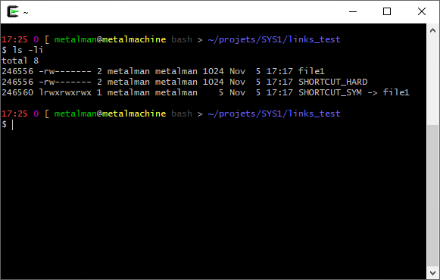
Links

Slide 102
Links & FS in UNIX
How to remove a file within the UNIX world of i-nodes ?

Slide 103
Links & FS in UNIX
A file is an i-node and a directory entry
An i-node has a counter of links
Just remove the link… unlink(2)
(How to create a file?... Create a link, and a directory entry)

Slide 104
Your kernel runs in memory, and processes manipulate data
The physical support is the mean to achieve persistence and it stores huge data (too big for memory)
In this point of view, the physical supports helps you to save your full context of work (applications and kernel states) between each reboot or power failure
The file system helps to organize data within a tree of files and directories, in order to avoid to browse within blocks

Slide 105
As the file system is a precise organization of data, it needs specific algorithms that do not work on other file systems.
There are 2 notions to distinguish:
The data stored following the « file system » organization
The program/code/driver to manipulate data organized with this « file system »
If you write some data in the FAT32 format, you cannot read/write it with a NTFS program or an ext2 program!

Slide 106
Virtual File System

Slide 107
VFS
( https://www.kernel.org/doc/html/latest/filesystems/vfs.html ) ( http://books.gigatux.nl/mirror/kerneldevelopment/0672327201/toc.html )
Abstraction above concrete file systems
A software layer between the file system driver and the processes
Regular syscalls can be used above all of the file systems
Currently, tightly linked with UNIX-likes
It has been ported on nearly all of the UNIX-likes
Inspired by existing concrete file systems
Ease the management of the files tree
Everything is a file in a tree (even devices)
Allows multiple other file systems to be « mounted » on the tree
No need to select a « volume » anymore: everything is in the tree

Slide 108
VFS
VFS:
Abstract structures and methods in memory
File System:
blocks/clusters and structures (Superblock, FAT, i-nodes, …) on physical support
Physical Support:
sectors

Slide 109
VFS
Kernel
VFS
FAT
NTFS
ext2
Notes:
Abstraction above concrete file systems…

Slide 110
VFS
Kernel
VFS
FAT
NTFS
ext2
NFS
Notes:
…but also above distant file system (like network file systems)…

Slide 111
VFS
Kernel
VFS
procfs
FAT
NTFS
ext2
NFS
Notes:
…and even very special modules (like ProcFS that exposes some kernel informations in the tree of files)

Slide 112
VFS: main concepts
Superblock
Informations about the physical support or the partition
Inode / i-node
index node: a structure describing each file and folder
dentry (and dcache)
Directory Entry: Pathname manipulated by the OS (stays in memory)
file
Representation of a file in memory

Slide 113
VFS: main concepts
« Superblock » and « i-node » in their VFS version are tighly linked to their equivalent in the concrete FS
Depending on the underlying FS, they might require an adjustment e.g.: FAT is not built upon « superblock » and « i-nodes »…
« dentry » and « file » are completly dissociated: they only exist as a structure in memory
They even are very different compared to their equivalent in ext2
They are more linked to the UNIX philosophy: « Everything is a file »

Slide 114
VFS: main concepts
Each of these structures exposes functions to the kernel
open/read/write/close/… use these functions
All the functions are not « implemented », in the sense that the underlying file system do not manage them
e.g.: changing the owner of a file on a FAT12 volume has no sense
Or even: llseek() on a pipe or a socket neither has any sense

Slide 115
VFS: Superblock
Describes the file system mounted
If the object underlying the file system is not a physical support, the superblock is generated on-the-fly and kept in memory e.g.: the list of devices (/dev), procfs (/proc), sysfs, … (see mknod(2))
Contains the attributes to manage the layers under
And even some methods/routines/procedures to manage the concrete underlying file system

Slide 116
VFS: Superblock
Attributes:
Device ID (ex: /dev/sda1)
Mount point (ex: /mnt or /media)
File system type
Max file size
Size of the blocks managed
Address of the 1st i-node on the device/partition, and the address of the i-node of the directory where the device is mounted on (except for « / ») ex: « mount /dev/sda1 /mnt » => the @ of the i-node of /mnt is also kept
Lock
…
Superblock operations (routines specific to the underlying FS)
…

Slide 117
VFS: Superblock
Superblock operations:
alloc_inode / destroy_inode
Create/Deallocates an i-node (in memory)
read_inode / write_inode
Read/Write the i-node on the physical support
drop_inode
Called when the last reference on an i-node is dropped (might call delete_inode)
delete_inode
Deletes the i-node from the physical support
…
write_super
Writes the Superblock on the physical support
statfs
Get statistics about the underlying file system
…

Slide 118
VFS: Superblock
VFS Superblock is mapped on concrete FS equivalent
In ext2: obviously, it is the ext2 Superblock
In FAT: « Partition Boot Sector », and a bit of the « FAT »

Slide 119
VFS: i-node
Structure containing attributes of the file
But still not his name
Attributes:
device ID
i-node number
mode (access rights)
owner ID
links counter
…
i-node operations (routines specific for the underlying FS)
…
[List of i-nodes, and list of dentries]

Slide 120
VFS: i-node
« Device ID + i-node number » are unique
2 ways for browsing through i-nodes:
Circular list of all the i-nodes
Hashmap using Superblock & i-node number as key
As it’s a « VFS » i-node, it is manipulated in memory!
Concrete modifications are written on the FS with the concrete routines given by the FS driver/program/…
Each file has an i-node
ls –i myfile.txt

Slide 121
VFS: i-node
i-node operations:
create(i-node, dentry, mode)
Creates a new i-node from a dentry
Called from a « creat » or « open » syscall
lookup(inode, dentry)
Searches the i-node corresponding to a filename (given in a dentry struct)
link/unlink/symlink
Creates/Removes a link (hard or symbolic) of a file in a dentry
Called from a « link », « unlink », or « symlink » syscall
mkdir/rmdir
Creates/Removes a directory from a dentry
Called from a « mkdir » or « rmdir » syscall
mknod
Creates a special file
Called from a « mknod » syscall
…

Slide 122
VFS: i-node
rename(i-node, dentry, i-node, dentry)
Moves an old file (dentry) from a directory (i-node), into another directory (i-node)
follow_link
Translates a symbolic link into the i-node it points to
truncate(i-node)
Modifies the size of the file pointed by an i-node
(Update the new size in the struct, then call this method)
permission(i-node, mask)
Checks if the rights given in mask are allowed on the i-node
…

Slide 123
VFS: i-node
VFS
Superblock
Superblock
i-node
i-node
i-node
i-node
i-node

Slide 124
VFS: dentry
Directory Entry
Structure for validating a pathname
Contains pointers to parents and childs dentries
Makes the link between the name and the i-node associated
Each part of the pathname is a dentry e.g.: /usr/bin/ls => 3 dentries (« usr », « bin », « ls »)
VFS dentries do not correspond to any structure stored on the concrete file systems
But they are used in a more or less similar manner than « direntries »

Slide 125
VFS: dentry
Attributes:
Dentry name
i-node of the folder which contains the dentry
Child dentries [list]
Subdirectories [list]
Parent dentry
Usage Count
Cache flag
Lock
Mount point (is this dentry a mount point for another FS?)
…
dentry operations (routines specific to VFS dentry)
…

Slide 126
VFS: dentry
Dentry state
When a dentry is tested (by a lookup), it is put in cache (in memory) in order to quickly access it again
3 states : used, unused, negative
Used: the dentry is associated with a valid i-node and is in use by at least one user (« usage count » not at 0)
Unused: the dentry is associated with a valid i-node, but nobody is using it (« usage count » at 0)
Negative: the pathname is incorrect, or the i-node pointed was deleted, but it is still in memory

Slide 127
VFS: dentry
We won’t see the cache in detail...
…but keep in mind that the VFS stores multiple lists of dentries in order to quickly resolve pathname...

Slide 128
VFS: dentry
…and keep also in mind that « any » pathname asked to the VFS (even those that do not exist/are invalid) are stored in these lists in memory.
This mechanism avoids to access too often the physical support: overused pathnames are already in memory.

Slide 129
VFS: dentry
Dentry operations:
revalidate
Checks if a dentry is valid within the cache
compare(pathname1, pathname2)
Compares two filenames
Might be implemented as a simple strcmp…
…or by a full check on the physical support « if » the concrete FS cannot assure that the pathname is different. Example: « /dir/file » and « /DIR/FILE » On UNIX, they are two different pathnames (strcmp is enough), but because FAT is not case sensitive (every name is stored in uppercase), it must be compared within the direntry on the physical support
…

Slide 130
VFS: dentry
VFS
Superblock
Superblock
i-node
i-node
i-node
i-node
i-node
dentry
dentry
dentry
dentry
dentry
dentry

Slide 131
VFS: file
Structure describing an opened file
It is a « file descriptor »
Keeps the state of the read/write cursor for a file descriptor
VFS files do not correspond to any structure stored on the concrete file systems
VFS file has a pointer to its VFS dentry, which points to its VFS i-node… which has a physical equivalent
VFS file also have attributes and specific operations

Slide 132
VFS: file
Attributes:
dentry associated
Mounted FS
Usage count
Access mode (permissions)
Offset within the file
Error code
List of event poll links (alarm for events on the file)
Owner UID
…
file operations (routines specific to VFS file)
…

Slide 133
VFS: file
File operations:
open
Creates a new file object and links it to the corresponding i-node
Called by the open syscall
mmap
Maps the file into the given address space
Called by mmap syscall
flush
Called whenever the « usage count » decreases (depends on the underlying FS)
release
Called when the last reference on the file is destroyed
Called when the last process using the file makes a close syscall
check_flags
Checks the flags given to fcntl syscall
Used on some FS (like NFS on network)

Slide 134
VFS: file
File operations:
llseek
Update the offset pointer
Called by a llseek syscall
read / write
Read/Write data into/from a buffer into a file from an offset, and update the struct
Called by a read/write syscall
aio_read / aio_write
Same as read/write, but asynchronously (we’ll see this later)
readdir
Return the next directory pointer
Called by readdir syscall
sendfile / sendpage
Send one VFS « file » to another one (usually: sending a physical file to a socket)
Stay in kerneland, do not copy data to userland! (the kernel buffer is transferred)

Slide 135
VFS: file
File operations:
fsync / aio_fsync
Writes all cache data into the file (synchronous and asynchronous versions)
Called by the fsync/aio_fsync syscall
poll
Waits for an event on the file (as any event on a file must pass through the VFS)
Called by a poll syscall
ioctl
Sends a command and an argument to a device
Called by an ioctl syscall
lock
Manipulates the lock on a file
…

Slide 136
VFS: dentry
VFS
Superblock
Superblock
i-node
i-node
i-node
i-node
i-node
dentry
dentry
dentry
dentry
dentry
dentry
file
file
file
file

Slide 137
VFS
VFS dentries and VFS files are just structures manipulated in memory
VFS Superblocks and i-nodes are structures in memory, but they also have an existence on the concrete FS
When a modification is done in the memory structure, they are marked as « dirty », because they must be written on the physical support before being really stored
A modification in a VFS file is repercuted in the i-node
And the i-node becomes « dirty », awaiting to be written on disk

Slide 138
How are all of those concepts working together in UNIX?

Slide 139
VFS & Processes: open(2) example
What’s happening when an open(2) is made?
The process calls the open(2) routine with parameters (filename and opening mode)
It passes in syscall mode (higher ring, supervisor, …) and calls a kernel function « sys_open() » with the filename and the opening mode

Slide 140
VFS & Processes: open(2) example
What’s happening when an open(2) is made?
A new file descriptor entry is made -> a VFS « file » is created
The filename is converted into a device ID + a VFS « i-node » number -> a VFS « dentry » is created

Slide 141
VFS & Processes: open(2) example
What’s happening when an open(2) is made?
The VFS « i-node » of the file is obtained with the « lookup() » method -> a VFS « i-node » is created
The VFS « i-node » of the file is used to fill various structures (particularly the VFS « file » created at the step 3)

Slide 142
VFS & Processes: open(2) example
What’s happening when an open(2) is made?
The « open() » method of the VFS « file » is called in order to access physically to the concrete file -> an « open » on the concrete file system is made
The file descriptor table is updated with a reference to the VFS « file » -> the file descriptor number is returned to the user

Slide 143
VFS & Processes
Opened Files Table
(File Descriptors)
VFS files
Process Control Block
VFS dentry
0
stdin
VFS i-node
1
stdout
2
stderr
i_count
f_count
files
f_pos
VFS dentry
VFS i-node
fs
File descriptors are the bridge between the VFS and the processes
i_count
fs_struct
(Current working directory)

Slide 144
What’s happening if there is a fork(2)?

Slide 145
VFS & Processes
When opening before a fork, the PCB and file descriptors are duplicated… but the VFS structures are still the same (The counter on the file increased, but not on the i-node: there is still only 1 VFS dentry pointing to it)
Parent process
File Descriptors
0
stdin
files
1
stdout
2
stderr
VFS files
fs
VFS dentry
VFS i-node
0
stdin
f_count 2
i_count 1
files
1
stdout
f_pos
2
stderr
fs
Child process
Notes:
Who increased the counter? When and why could it happen?

Slide 146
VFS & Processes
When opening after a fork, the VFS file structure is created two times, and the i-node count is increased
Parent process
File Descriptors
0
stdin
files
1
stdout
VFS files
2
stderr
fs
f_count 1
f_pos
VFS dentry
VFS i-node
0
stdin
files
1
stdout
2
i_count 2
stderr
fs
f_count 1
f_pos
Child process
Notes:
Who increased the counter? When and why could it happen?

Slide 147
Abstraction seen from the userland

Slide 148
File System Syscalls
open, read, write, close, lseek, …
Access to the file
mkdir, rmdir, opendir, readdir, closedir, chdir, unlink, …
Access to the directory
symlink, readlink
Access to a symbolic link
stat, access, chmod, chown, …
Access to the informations about a file or a directory
fstat, fcntl, …
Access to the file descriptor

Slide 149
File System Syscalls: open
open(char *pathname, int flags, [mode_t mode])
Opens a file for reading or writing
Pathname: the pathname to the file
Flags: the options explaining what the program expects
[Mode: permissions in case of a file creation]
Don’t forget you can make a binary OR « | » on the flags and mode

Slide 150
File System Syscalls: open
open(char *pathname, int flags, [mode_t mode])
Flags:
O_RDONLY, O_WRONLY, ORDWR read only, write only, read and write
O_CREAT create a file if it does not exist (if with O_EXCL, a failure will happen if the file already exists)
O_TRUNC empty the file if it exists
O_APPEND place the cursor at the end of the file (useful for writing…)
O_SYNC Activates the synchronization mode, each write will be made on the disk immediatly

Slide 151
File System Syscalls: open
open(char *pathname, int flags, [mode_t mode])
Mode:
S_ISUID, S_ISGID, S_ISVTX setuid, setgid, sticky bit (see chmod(2) and sticky(7))
S_IRUSR, S_IWUSR, S_IXUSR, S_IRWXU
Owner: read, write, execute, Read/Write/eXecute
S_IRGRP, S_IWGRP, S_IXGRP, S_IRWXG
Group: read, write, execute, Read/Write/eXecute
S_IROTH, S_IWOTH, S_IXOTH, S_IRWXO
Others: read, write, execute, Read/Write/eXecute

Slide 152
File System Syscalls: close
close(int fd)
Closes a file descriptor
fd: The file descriptor to close
The file descriptor entry is removed, therefore, the VFS « file » counter is reduced
If the VFS « file » counter is at 0, it is removed, and the VFS « i-node » counter is therefore also reduced

Slide 153
File System Syscalls: lseek
lseek(int fd, off_t dep, int option)
Moves the read/write cursor within the file
Returns the new position from the beginning of the file
fd: The file descriptor pointing to the file
dep: The length (in bytes) to shift
option: From which point the shhift must be done
SEEK_CUR from current cursor position
SEEK_SET from the beginning of the file
SEEK_END from the end of the file

Slide 154
File System Syscalls
About permissions:
Adds the rights you want with a simple bitfield
4 / R = Read
2 / W = Write
1 / X = eXecute
7 = 4 + 2 + 1 => 111
Owner X00 XXX------
Group 0X0 ---XXX---
Others 00X ------XXX

Slide 155
File System Syscalls
About special permissions on executable programs:
SETUID (or SUID, or Set User ID)
The process created will run with the UID of the owner of the file
SETGID (or SGID, or Set Group ID)
The process created will run with the GID of the group of the file
Sticky Bit (obsolete)
The text segment of the program is kept in memory after the execution

Slide 156
File System Syscalls
About special permissions on directories:
SETUID (or SUID, or Set User ID) [No use for directories]
SETGID (or SGID, or Set Group ID)
The files/folders created within a parent folder with SETGID activated will be created with the GID of the parent folder (and the new subfolders will also get the SETGID permission)
Sticky Bit
A user cannot delete or rename files owned by others within a folder with the sticky bit activated

Slide 157
File System Syscalls: umask
About permissions: umask
Blocks the selected bits within the calls to open(2), mkdir(2), mkfifo(2)
Default value: 022 (Write for owner, but not for group and others)
Works exactly like a « mask »
Just inverse values…
umask 777 = Cancels all the rights to everyone
umask 000 = Allows any right to anyone

Slide 158
File System Syscalls: mkdir
mkdir(char *pathname, mode_t *mode)
Creates a directory
UID and GID are used, and the umask is applied
Beware, mkdir(2) is not automatically recursive
Pathname: the pathname where to create a directory
Mode: permissions to write in case of a file creation

Slide 159
File System Syscalls: stat
stat(char *pathname, struct stat *buf)
Get informations about the object pointed by pathname
Pathname: the pathname to the file
Buf: a buffer in memory that will be filled by stat(2) (if it succeeds)

Slide 160
File System Syscalls: stat
struct stat (see <sys/stat.h>)
st_dev ID of the device containing the object
st_ino i-node number of the object
st_mode Status of the object (permissions & more)
st_uid, st_gid UID and GID of the owner of the object
st_nlink Number of links pointing to the object
…
st_size Size of the object in bytes
st_blocks Number of blocks used (512 Bytes « blocks »)
st_blksize Size of the blocks for the I/O with the device
…
st_[a/c/m]time Timestamp for last access/status change/modification

Slide 161
File System Syscalls: stat
struct stat (see <sys/stat.h>)
st_size Size of the object in bytes
st_blocks Number of blocks used (512 Bytes « blocks »)
st_blksize Size of the blocks for the I/O with the device
touch TEST
Stat output:
File size (B): 0
Nb blocks: 0
Block size: 4096
touch TEST2
echo "a" > TEST2
Stat output:
File size (B): 2
Nb blocks: 8
Block size: 4096

Slide 162
File System Syscalls: stat
struct stat (see <sys/stat.h>)
st_mode Status of the object (permissions & more)
Permissions can be tested with the S_IRWXU, …
Just test a lot of cases as previously seen
Other special cases concerns the type of file

Slide 163
File System Syscalls: stat
S_ISREG(m) is it a regular file?
S_ISSOCK(m) socket?
S_ISFIFO(m) named pipe?
S_ISCHR(m) character device?
S_ISDIR(m) directory?
S_ISLNK(m) symbolic link?
S_ISBLK(m) block device?

Slide 164
File System Syscalls
About character and block devices:
Character devices are devices that work with characters
e.g.: Keyboard, terminal, …
Keyboards and terminal manages characters
Block devices are devices that read/write blocks
e.g.: Hard drive, network, …
Hard drives manipulate sectors or blocks
Network cards manipulate IP packets or frames

Slide 165
The VFS contributes actively to abstract more the management of files either they are stored on « real » devices or just a kernel extension.
File descriptors, thanks to their structure and fork(2) behavior, allow to share access to the same files…
…however, the reading/writing cursor is also share in some cases!
How to manage concurrency challenges?

